Slide 1

Final Project
Mood based recommendation system

Slide 2
Agenda
Problem statement
Data cleaning
EDA
Training models
Validation
Presentation Title

Slide 3

Problem statement
Design a machine learning model that classifies a user’s mood based on physiological signals such as heart rate, skin temperature, and eye-blink rate. Once classified, recommend a suitable music genre (e.g., Happy → Pop, Stressed → Lo-fi) to enhance the user’s emotional state.

Slide 4


Primary goals
Data cleaning

Slide 5





WORKFLOW ON DATA CLEANING
Missing values
Outlier detection
Categorical data
Feature engineering
Scaling
Filling the missing values with suitable statistics
Very few data were outliers, those were little above the margin, hence capped them to high value.
Label encoded the categorical data
Created extra columns out of available one
Scaling all features for reducing the computational complexes

Slide 6
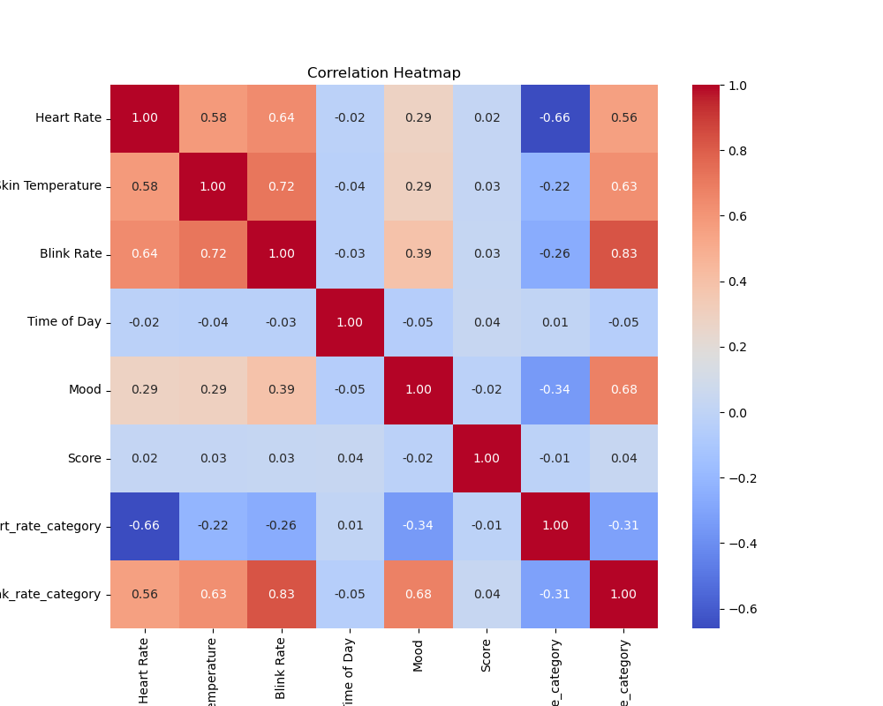
EDA

Slide 7
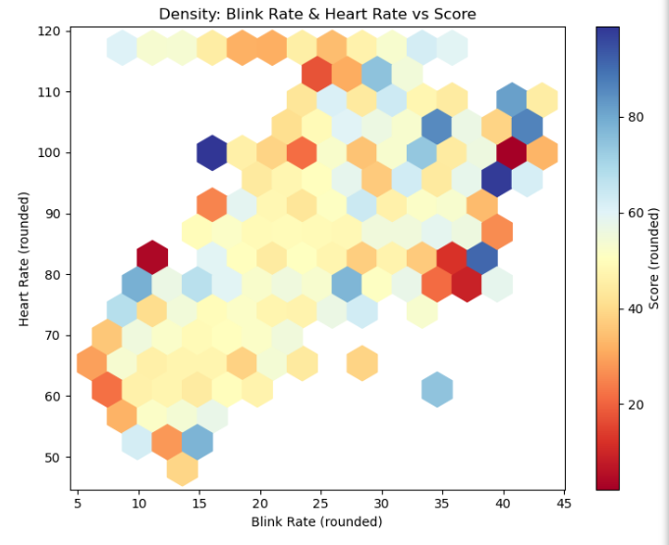
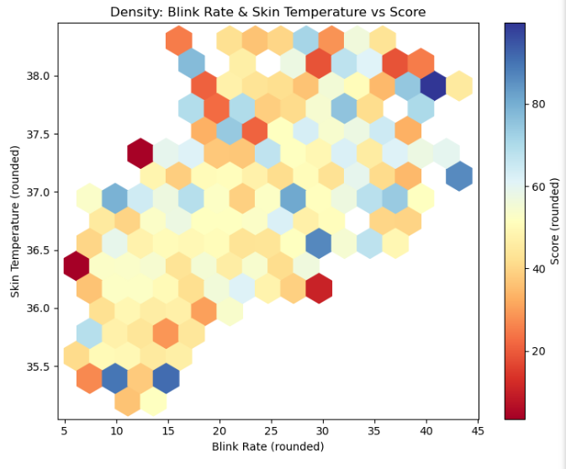
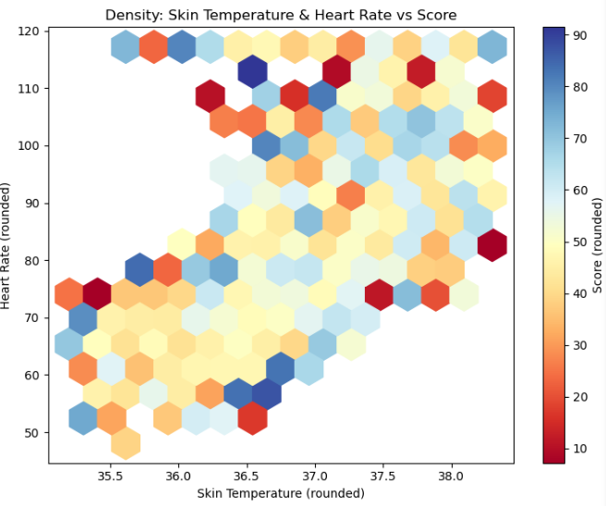
EDA

Slide 8
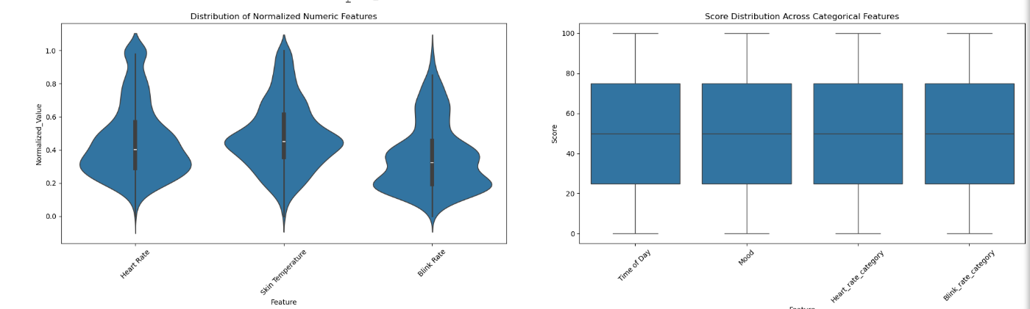
EDA

Slide 9

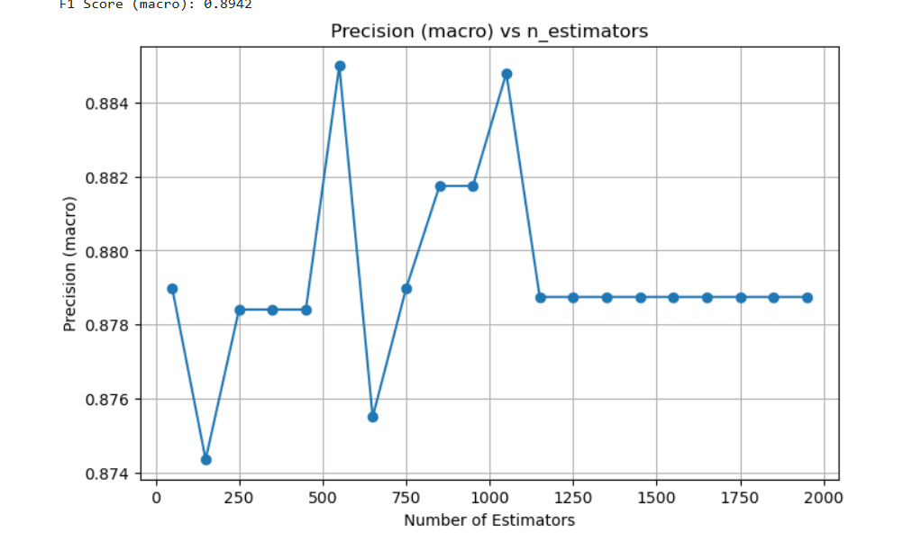


Training model
Feature selection
Split the data into features and target.
Used 80% of the data for training and rest for testing
Model building
Initially checked whether every data is scaled and present in numeric form
Build XGB Classifier model since our problem is to classify the mood of a person
Metrics used
Mlogloss for predicting the mistake
Building more trees to see the trend as we increase the number of trees

Slide 10
Validation
Metrics | Percentage
Accuracy | 88.3
Precision | 88.4
F1-score | 88.3
Recall | 88.3

Slide 11




Thank you
C Sutharsan

